Slide 1
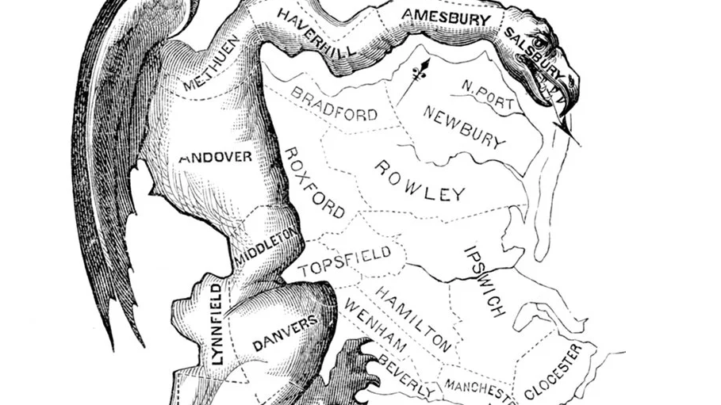
Taichung 2nd district gerrymandering analysis
IE532- Analysis of Network Data
Chen Wang/JoTing Wang/SzuMin Chao
Reference: [2]

Slide 2




Outline
Background
Model definition
Conclusion
Summary

Slide 3
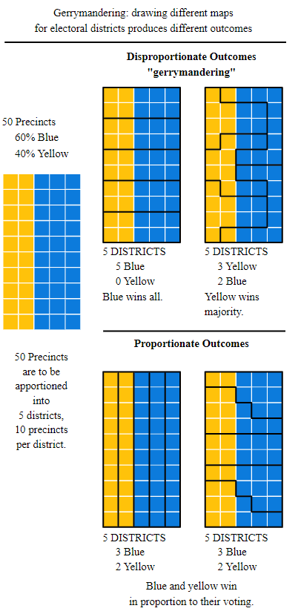
Rare-earth elements (REEs):
Background | Model definition | Conclusion | Summary
Chapter 1: Background information(Gerrymandering) (1/3)
Due to the change of communities, reassigning the districts is critical to our democracy
Maps must be redrawn to ensure the districts are equally populated, comply with laws such as the Voting Rights Act, and are otherwise representative of a state’s population.[1]
The practice of drawing the boundaries of electoral districts in a way that gives one political party an unfair advantage over its rivals.[2]
Reference: [2]

Slide 4
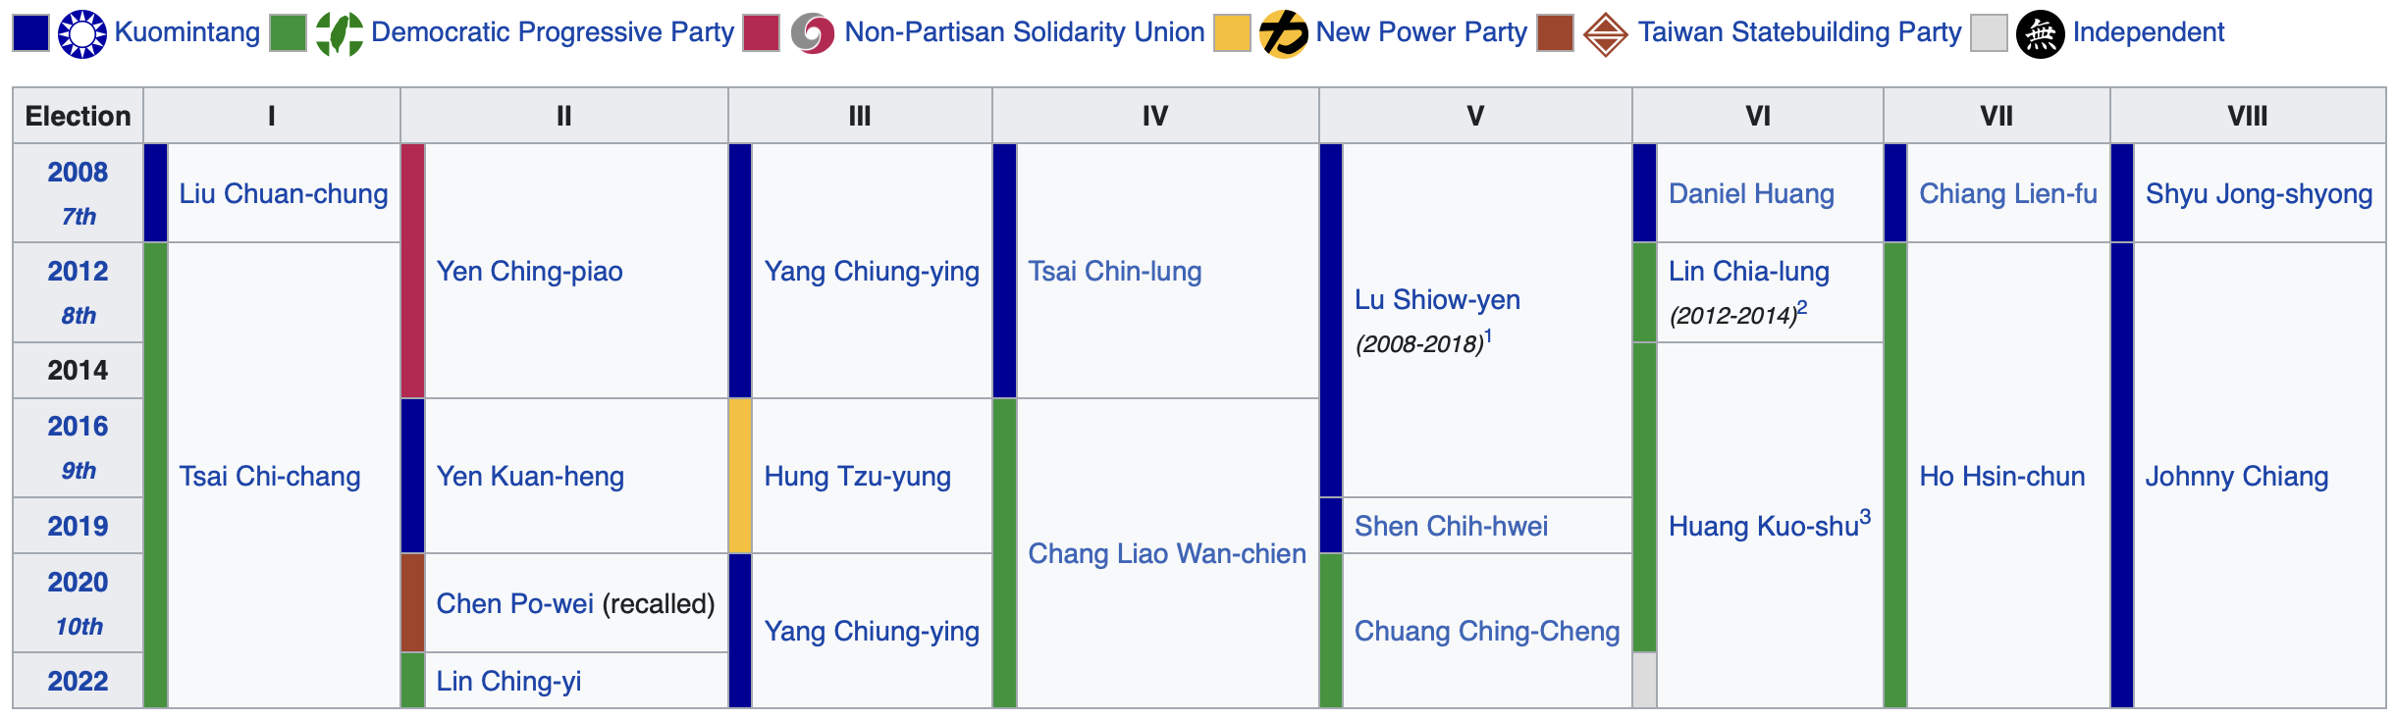
Rare-earth elements (REEs):
Background | Model definition | Conclusion | Summary
Chapter 1: Background information(Taichung's legislators rearrangement) (2/3)
The legislator districts in Taichung need to be redistributed.[1]
Some districts in Taichung contain people from coastal areas to inland areas. However, the demand of those areas are completely different. In order to that, those areas should not be put together.[3]
For your reference, DPP and KMT are the two biggest political parties in Taiwan. The representative color of DPP is green, and the representative color of KMT is blue. Our goal is to redistribute the legislator districts in Taichung and show the results under different conditions.[4]
Reference: [4]

Slide 5
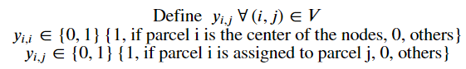
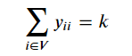
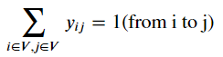
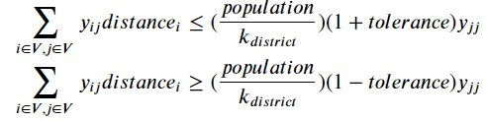
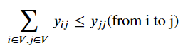
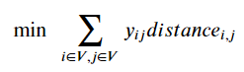
[{"metadata":{"id":"WDA25bWao-WL"},"id":"WDA25bWao-WL","cell_type":"markdown","source":"## Chapter 1: Introduction(Background information)\n\n**Gerrymandering:**\n- Due to the change of communities, reassigning the districts is critical to our democracy.\n- Maps must be redrawn to ensure the districts are equally populated, comply with laws such as the Voting Rights Act, \nand are otherwise representative of a state’s population. [(Refernce)](http://rportal.lib.ntnu.edu.tw:8080/server/api/core/bitstreams/b16a93bd-c5dd-43d8-8090-918fcfe47b0b/content) \n- The practice of drawing the boundaries of electoral districts in a way that gives one political party an unfair advantage over its rivals. [(Gerrymandering)](https://en.wikipedia.org/wiki/Gerrymandering)\n\n**Taichung's leglilator rearrangement:**\n- The legislator districts in Taichung need to be redistributed. [(Refernce)](http://rportal.lib.ntnu.edu.tw:8080/server/api/core/bitstreams/b16a93bd-c5dd-43d8-8090-918fcfe47b0b/content)\n- Some districts in Taichung contain people from coastal areas to inland areas. However, the demand of those areas are completely different. In order to that, those areas should not be put together.[(Reference)](https://michaelturton.blogspot.com/2008/02/gerrymandering.html)\n- Our goal is to redistribute the legislator districts in Taichung, and show the results under different conditions.\n- For your reference, DPP and KMT are the two biggest political parties in Taiwan. The representative color of DPP is green, and the representative color of KMT is blue. [(Taichung legislative background)](https://en.wikipedia.org/wiki/Legislative_Yuan_constituencies_in_Taichung_City)\n![2008-2022_Taichung's legislator](feature/Taichung_legislative_conditions.png)\n\n- To make our project more intuitive, we have combine the data from other small parties into DPP or KMT based on their political tendency."}]
Background | Model definition | Conclusion | Summary
Chapter 4: benefit to DPP(the winner to win more)
Follow the chapter 3’s variables and the constraints
Items | Formula
Variables | k = k_district Distance = the shortest length from i to j Population = the overall votes of Taichung Tolerance = Allowed bound
Constraints
Objective function
Known variables
Unknown variables
1
5
2
3
4
1
2
3
4

Slide 6
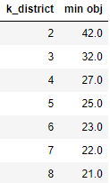
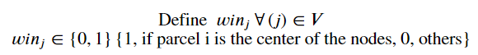
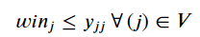
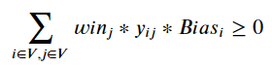
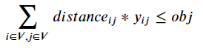
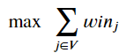
Background | Model definition | Conclusion | Summary
Chapter 5: benefit to DPP(the winner to win more)
Follow the chapter 4’s variables and the constraints
Items | Formula
Variables | 5. Obj >= min_obj
Constraints
 | Modify the chapter 3’s objective function to be a constraint
Objective function
Known variables
7
Unknown variables
6
5
6
7

Slide 7
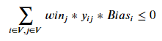
Background | Model definition | Conclusion | Summary
Chapter 6: benefit to KMT(the loser to loss less)
Follow the chapter 4’s variables and the constraints
Follow the chapter 5’s variables and the constraints except for the constraints
Items | Formula
Variables | 5. Obj >= min_obj
Constraints
 | Modify the chapter 3’s objective function to be a constraint
Objective function
Known variables
7
Unknown variables
6
5
6
7

Slide 8
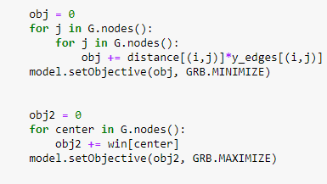
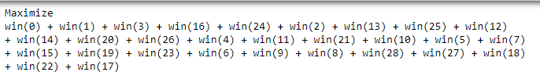
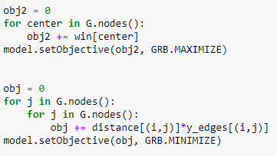
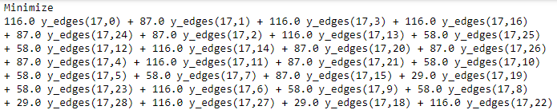
Background | Model definition | Conclusion | Summary
Can only set one objective function (the last one)
Examples | Input | Actual Output
Min obj + Max obj2 |  | Only set the maximize(1st) function
Max obj2 + Min obj |  | Only set the minimize(1st) function

Slide 9
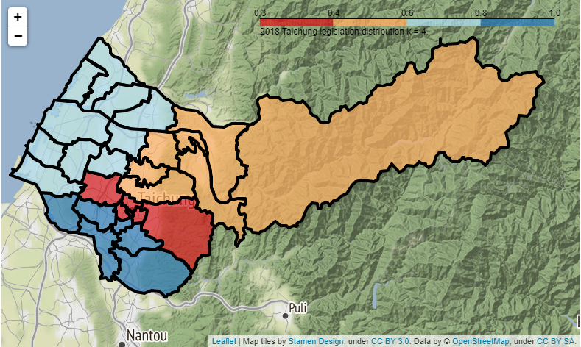
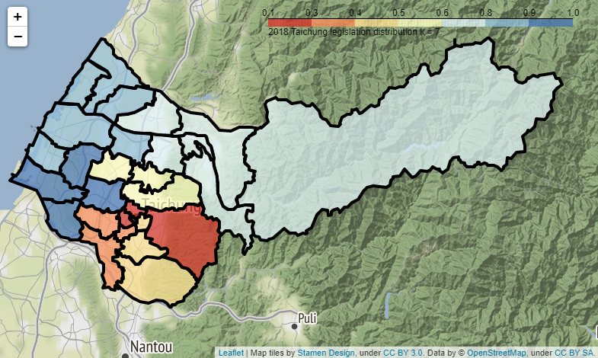
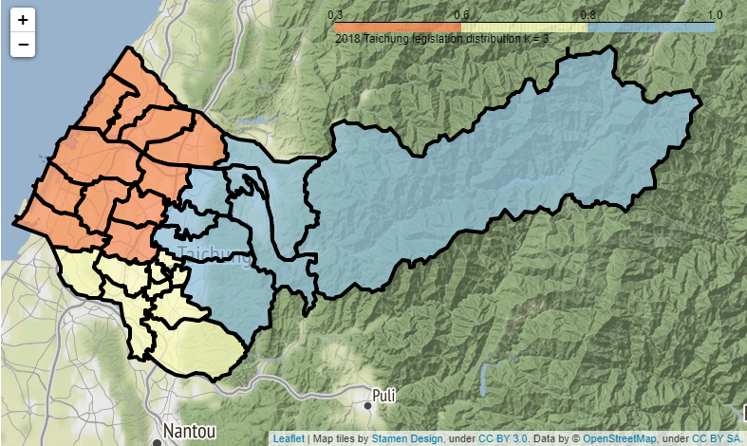
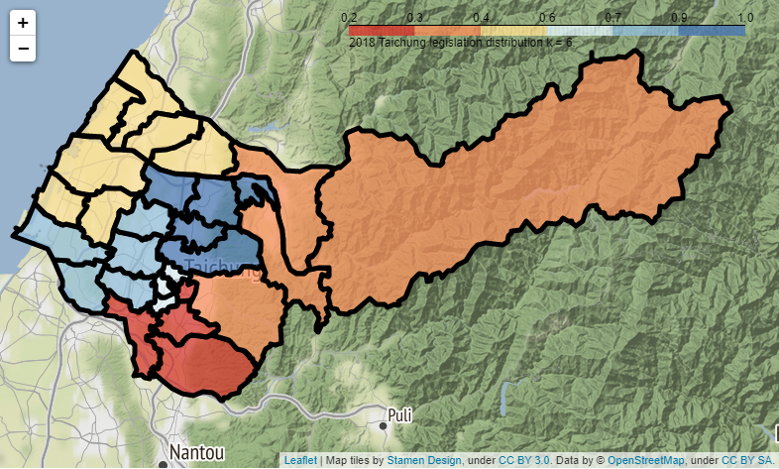
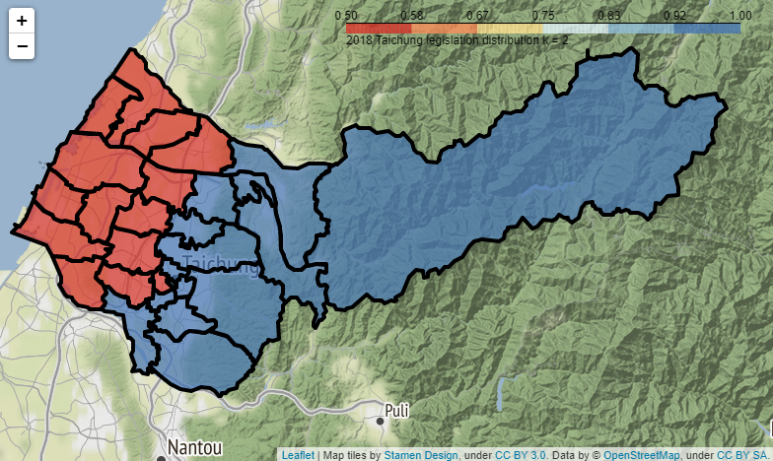
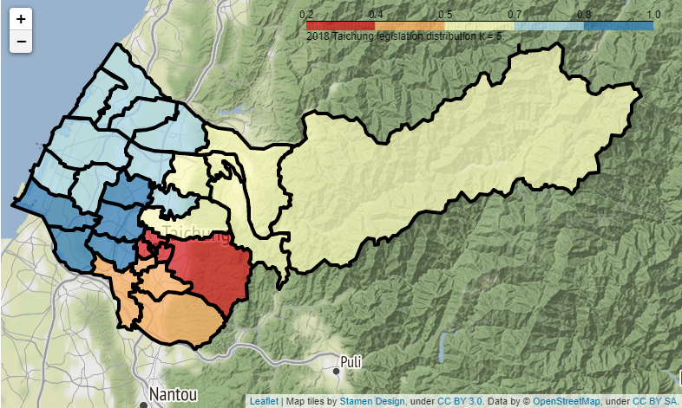
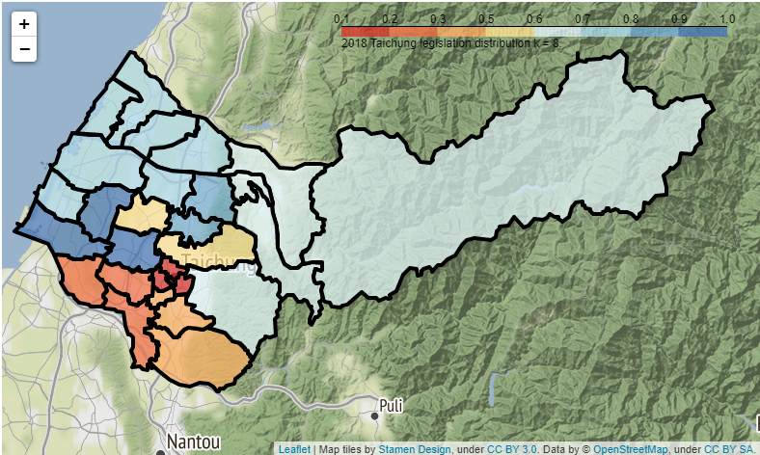
Background | Model definition | Conclusion | Summary
Chapter 4 :Geographical map
Tolerance = 0.2
K | Geo-map
5
6
7
8
(-22%<cur<+16%)
K | Geo-map
2
3
4

Slide 10
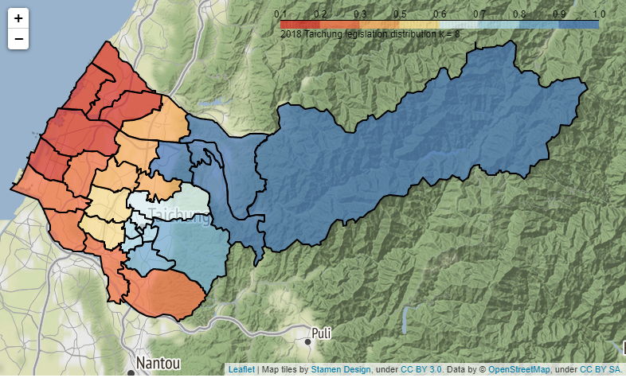
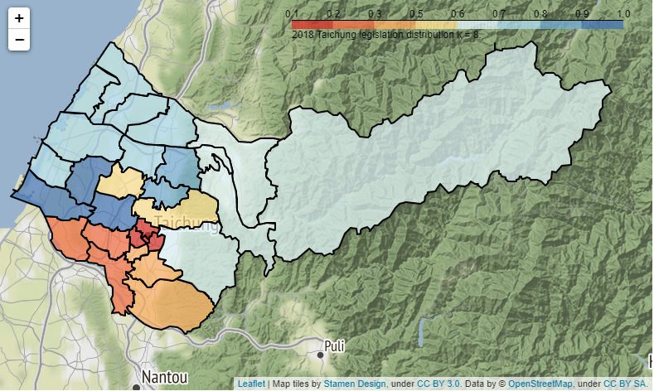
Background | Model definition | Conclusion | Summary
Chapter 4 : K = 8
Type | Taichung’s geo-map
Current
Re-arrangement
Can not need to connect to coastal and mountain area (Too broad)
Gerrymandering susception
Coastal area
Mountain area
Total_pop = 181,395
Total_pop = 171,995

Slide 11
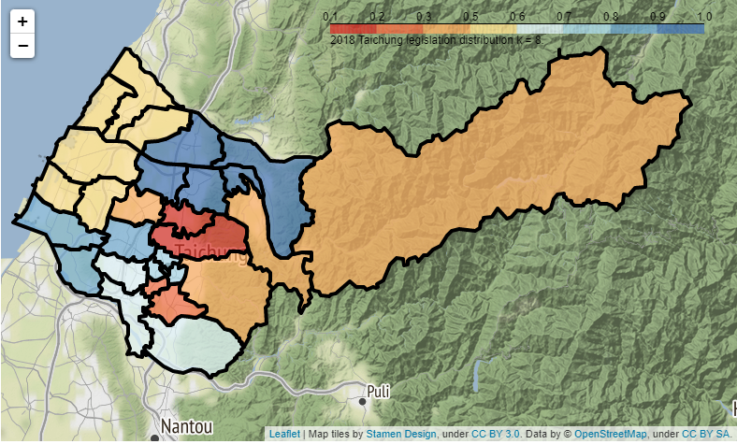
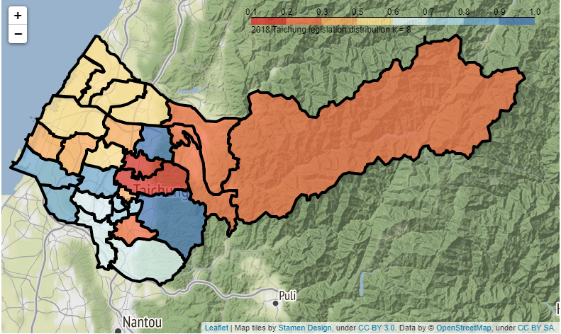
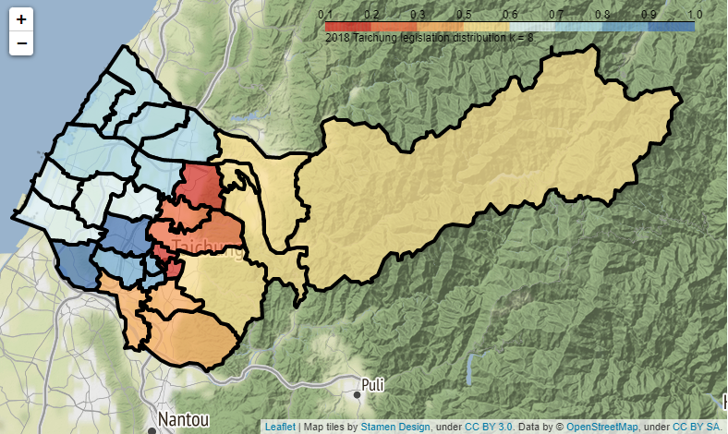
Background | Model definition | Conclusion | Summary
Chapter5: benefit to DPP (k_district = 8)
k_district | tolerance | legislator number | obj | graph
8 | 0.1 | - | 20 | Unavailable
 |  | - | 21 | Unavailable
 |  | 7 | 22 | Connected
 |  | 8 | 23 | Disconnected
 |  | 8 | 24 | Disconnected
 |  | 8 | 25 | Disconnected
 | 0.2 | - | 20 | Unavailable
 |  | 7 | 21 | Connected
 |  | 8 | 22 | Connected
 |  | 8 | 23 | Connected
 |  | 8 | 24 | Disconnected
 | 0.3 | - | 20 | Unavailable
 |  | 7 | 21 | Connected
 |  | 8 | 22 | Connected
 |  | 8 | 23 | Disconnected
 |  | 8 | 24 | Disconnected
 | 0.4 | - | 20 | Unavailable
 |  | 7 | 21 | Connected
 |  | 8 | 22 | Connected
 |  | 8 | 23 | Disconnected

Slide 12
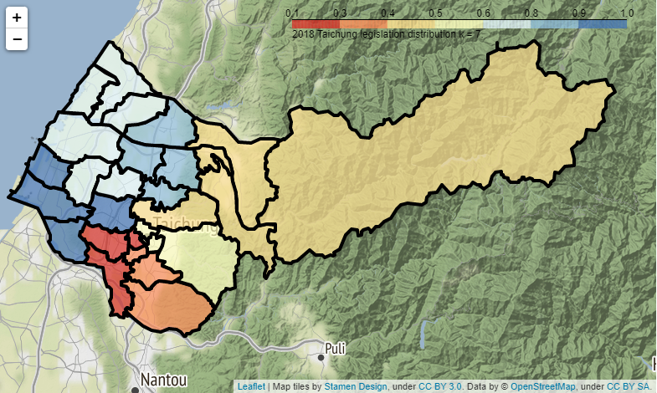
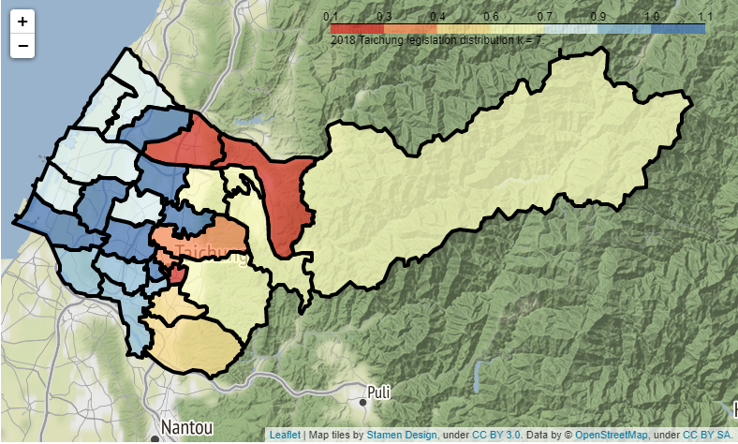
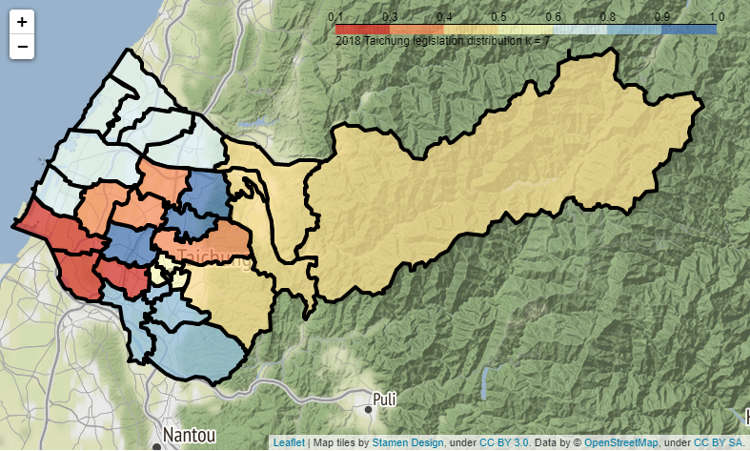
Background | Model definition | Conclusion | Summary
Chapter5: benefit to DPP (k_district = 7)
k_district | tolerance | legislator number | obj | graph
7 | 0.1 | - | 20 | Unavailable
 |  | - | 21 | Unavailable
 |  | 5 | 22 | Connected
 |  |  | 23 | Disconnected
 | 0.2 | - | 20 | Unavailable
 |  | - | 21 | Unavailable
 |  | 6 | 22 | Connected
 |  | 7 | 23 | Disconnected
 |  | 7 | 24 | Disconnected
 | 0.3 | - | 20 | Unavailable
 |  | - | 21 | Unavailable
 |  | 6 | 22 | Connected
 |  | 7 | 23 | Connected
 |  | 7 | 24 | Disconnected
 | 0.4 | - | 20 | Unavailable
 |  | - | 21 | Unavailable
 |  | 6 | 22 | Connected
 |  | 7 | 23 | Connected
 |  | 7 | 24 | Disconnected

Slide 13
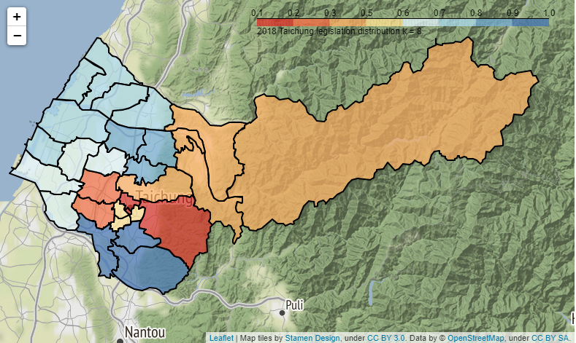
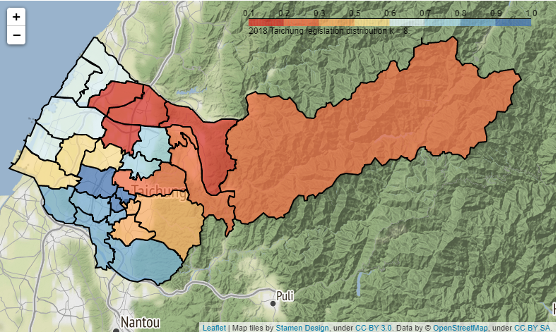
Background | Model definition | Conclusion | Summary
Chapter6: benefit to KMT (k_district = 8)
k_district | tolerance | legislator number | obj | graph
8 | 0.1 | - | 20 | Unavailable
 |  | - | 21 | Unavailable
 |  | 3 | 22 | Connected
 |  |  | 23 | Connected
 | 0.2 | - | 20 | Unavailable
 |  | 3 | 21 | Connected
 |  | 3 | 22 | Connected
 |  | - | 23 | Unavailable
 | 0.3 | - | 20 | Unavailable
 |  | 3 | 21 | Connected
 |  | - | 22 | Connected
 | 0.4 | - | 20 | Unavailable
 |  | 3 | 21 | Connected
 |  | - | 22 | Connected
 | 0.5 | - | 20 | Unavailable
 |  | 4 | 21 | Connected
 |  | 4 | 22 | Connected
 |  | - | 23 | Connected
 | 0.6 | - | 20 | Unavailable
 |  | 4 | 21 | Connected
 |  | 4 | 22 | Connected
 |  |  | 23 | Disconnected

Slide 14
Background | Model definition | Conclusion | Summary
Summary:
The number of objective function in gurobi can be only one.
The rumor of gerrymandering may be convincible.
The best result for the DPP party (the winner to win more) is 8:0 when the k_district is equal to 8.
The best result for the KMT party (the loser to loss less) is 4:4 when the k_district is equal to 8.

Slide 15

Thank you!
Notes:
Thank you!!

